Slide 1
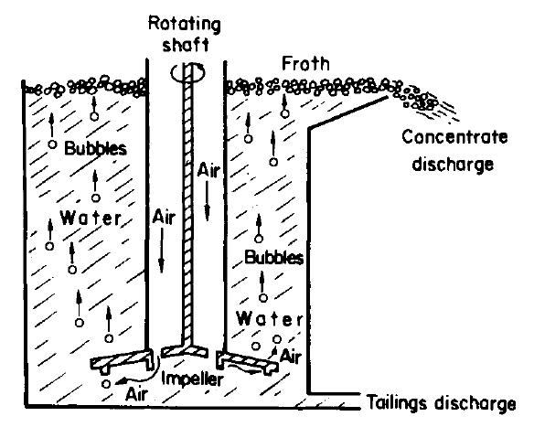
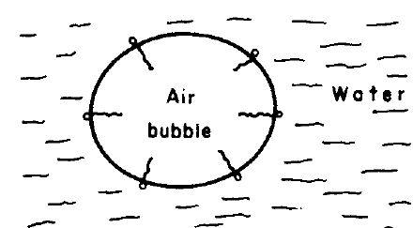
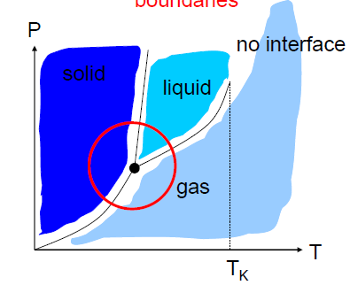
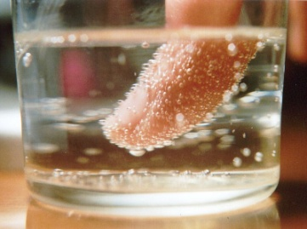
Interfacial Phenomena
Examining the energy of the interface between phases, nucleation of a new phase in a parent phase, and transport phenomena at interfaces.

Slide 2
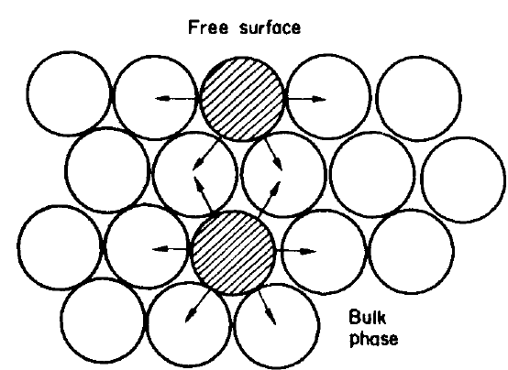
Surface Energy and Surface Tension
A particle in the surface of a liquid or solid has no neighbours on the "free" side —assuming that no matter exists on that side of this "free surface"
The energies of bonds between particles are negative because energy is evolved when a bond is formed.
This means that the energy of a particle in a free surface is higher than that of a particle in the bulk phase
If the area of a surface is increased → the energy of the surface increases
we can define the surface free energy _{γ} as the energy required to create 1 m² of new surface, measured in joules per square metre.

Slide 3
Liquids clearly possess surface energy, which is a characteristic property of the phase making up the free surface, and because a reduction in the surface area of the liquid results in a reduction in free energy of the system the surface of the liquid will tend to contract as far as possible.
Spheres have the smallest surface area to volume ratio of all geometrical shapes, and liquids will tend to form spherical drops as far as other constrictions,
This tendency of liquid surfaces to contract causes a tensional force in the free surface called the surface tension γ , defined as the force in Newton's acting at right angles to a line 1 m long in the surface.

Slide 4
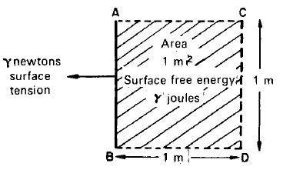
The work done in producing l m² of new surface is equivalent to the work done in stretching the surface by 1 m along a 1 m line against the surface tension, and this is the surface free energy.
AB is a line 1 m long in the surface of a liquid. The energy required to stretch the liquid surface to CD from AB is γ joules if BD is 1 m and the surface tension is γ newtons per metre.
Thus the surface tension is γ newtons per metre, is numerically equal to the surface free energy and has the same dimensions
Solids will certainly have surface free energy, but the concept of surface tension in solids is difficult because they have rigid surfaces

Slide 5
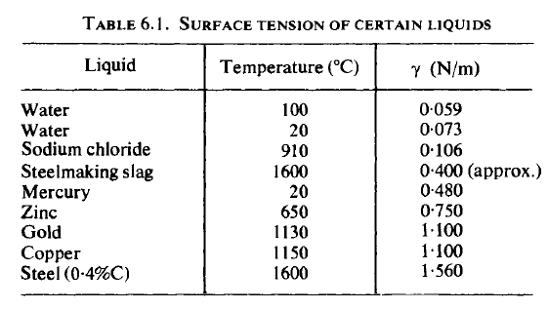
Surface tension measurements with liquids involve the measurement of the force required to create surfaces in the form of bubbles or drops
The surface is never really "free“ because it is bounded by a gas and, conventionally, measurements are made in air saturated with the vapour of the liquid.
Different values are obtained if the gas is the vapour of the liquid alone or if other gases than air, such as argon, are used.
Clearly, surface tension measurements for liquid metals involve special experimental problems, such as oxide contamination of the surface, refractory containers and temperature control, and measurements must be made in an inert gas atmosphere.

Slide 6
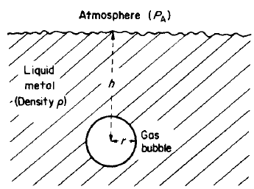
An example of the importance of surface tension is the problem of the nucleation of gas bubbles in liquid metals.
The pressure on a spherical gas bubble in a liquid metal at a
certain distance from the surface of the metal can be calculated,

Slide 7
The total pressure P_{B} in the gas bubble must at equilibrium, be equal to the sum of the atmospheric pressure P_{A}, the pressure due to the head of metal P_{M}, and the
pressure required to maintain the metal/gas surface of the bubble against the surface tension, Pγ. Thus
P_{M} is
Pγ can be calculated as follows:

Slide 8
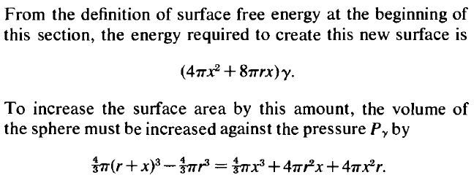
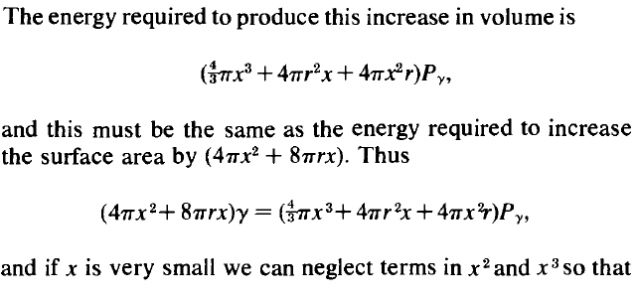

Slide 9
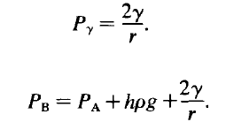

Slide 10
Nucleation
is the first step in the formation of either a new thermodynamic phase or a new structure via self-assembly or self- organization .
or
is typically defined to be the process that determines how long an observer has to wait before the new phase or self-organized structure appears
If a pure material is kept at its freezing point, there will be no solidification. It needs some undercooling for the liquid to solid transformation to take place. More importantly, there is a critical undercooling above which there is almost no nuclei that form and below which there is an explosion in the number of nuclei that form. Why?

Slide 11
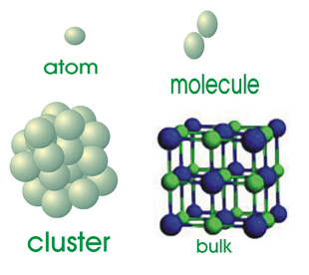
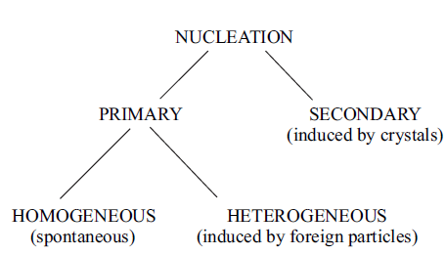

Slide 13
Homogeneous nucleation
Consider a pure melt which is cooled below its melting temperature. Such a liquid is known as undercooled.
Let a small volume Vs of the liquid turn into solid.
If G_{s} is the free energy per unit volume of the solid, and G_{l} that of the liquid, if A_{ls} is the solid-liquid interfacial area, and if γ_{sl} is the interfacial free energy, then, the total free energy of the system is given by
Before the small volume of solid formed, the free energy of the system is given by

Slide 14
Thus, the total free energy change associated with the transformation of a
small volume of liquid Vs insto solid is given by
Note that the interfacial energy is always positive. Hence the contribution from the second term is always positive. However, depending on whether the liquid is above or below the melting temperature, ΔG is positive or negative.
where G is negative, the system will try to minimize the shape in such a way that the overall interfacial energy is reduced so that the maximum reduction in free energy can be achieved.

Slide 15
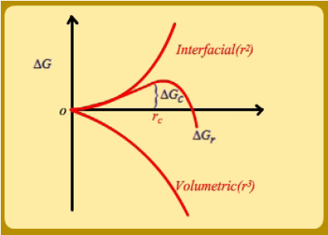
If we assume interfacial energy to be isotropic, then the volume transformed is a sphere of radius r (since the maximum volume is enclosed for the minimal surface area for a sphere), we get
ΔG = ΔH - tΔs
latent heat of fusion per unit volume (Lf,v)
ΔS= (Lf,v / T0,
—there will only be one temperature at which the liquid is in equilibrium with the solid, T0.
In Fig. , we show the variation of the volume free energy, interfacial energy and the overall free energy change as a function of r.

Slide 16
Since the interfacial contribution goes as r² and that of bulk free energy as r³, at smaller r, interfacial energy always dominates, and being a positive energy, it actually suppresses the formation of solid. Unless the size of the solid is above some size wherein the (negative) bulk free energy change can more than compensate for the (positive) interfacial energy, the solid will not be stable (even if it forms). Thus, one can identify the critical radius of the solid that is stable when formed in the undercooled liquid by minimizing G with respect to r:

Slide 17
In other words, there is a critical radius for which the overall free energy
change is zero;
any particle above this size will reduce the overall free energy and any particle below this size will increase the overall free energy.
In the nucleation literature, particles which are smaller in size than the critical radius are known as embryos.

Slide 18
Critical undercooling
Consider any liquid. Inside the liquid, due to thermal fluctuations, clusters of various sizes keep forming. The probability of finding a cluster of given radius r is given by the Boltzmann distribution:
where n₀ is the total number of atoms, k_{B} is the Boltzmann constant, and G is the free energy change associated with the formation of a solid of size r
Above the melting temperature of the solid, any such cluster that forms also breaks down immediately.
However, below melting point, that is, in an undercooled melt, if the radius of the cluster formed is greater than rc, then, that cluster becomes part of a solid and the given equation is no longer valid.

Slide 19
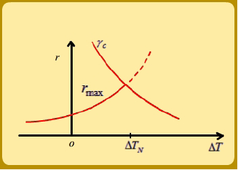
Using the above equation for thermal fluctuations, it is also possible to calculate the size of the biggest cluster (of radius, say, rmax) that has a reasonable probability of occurence.
In Fig., we show the variation of this cluster size as a function of undercooling T. In the same plot, we have also shown the variation of r_{c} with undercooling.
From this plot, it is clear that there is a critical undercooling at which these two curves intersect; in other words, due to thermal fluctuations, there is a reasonable probability to form a cluster of size equal to the critical nucleus size. Thus, when this undercooling is reached, one expects that homogeneous nucleation will take place in the undercooled melt.

